Slide 1
Protein Structure Prediction
Reporter: Chia-Chang Wang
Date: April 1, 2005

Slide 2
Introduction
Why do we need protein structure prediction?
  X-ray Crystallography, Nuclear Magnetic Resource(NMR) and Molecular Dynamics(MD)
  Expensive, time-consumong, sensitive to the experimental conditions and limit to small or medium protein

Slide 3
Prediction of Protein Structures
Homology Modeling
Homology modeling, which is also called knowledge base modeling, is based on the theory of the property of reservation for homology protein tertiary structure
Ab Initio Methods
These methods can be contrasted to the threading methods for fold assignment without reference from other known structures.

Slide 4
Homology Modeling
Presuppoition:
  Little changes on protein sequence would also alter little changes on structure.
  protein identity > 30%

Slide 5
Homology Modeling(cont.)
General Processes:
  Datebase search and template select
  Multiple sequence alignment
  Framework construction, loop structure and side-chains simulation
  Energy minimization
  Reasonableness evaluation

Slide 6
Homology Modeling(cont.)
Datebase search
  Swiss-prot, PDB
  Classification: CATH,SCOP
Template select
  Resolution < 3Å
  Complete protein
  Closest functional site with the target unknown protein structure, such as the ligand-bound receptor, active site of an enzyme, etc
Notes:
CATH:(Class(C), Architecture(A), Topology(T) and Homologous superfamily (H)
SCOP:Structural Classification of Proteins
especially those annular structures at larger proteins may be ignore because of inability to analyze the residues.

Slide 7
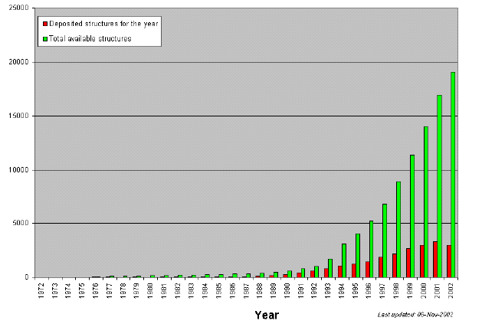
Homology Modeling(cont.)

Slide 8
Homology Modeling(cont.)
Multiple sequence alingment
  Alignment algorithm, ClustalW
  Structural superposition
  Secondary structure prediction
  →Structural reserved blocks

Slide 9
Homology Modeling(cont.)
Score function for alignment of protein sequences
Query Length | Substitution Matrix | Gap Costs
 |  | Creation | Extension
<35 | PAM-30 | 9 | 1
35-50 | PAM-70 | 10 | 1
50-85 | BLOSUM-80 | 10 | 1
>85 | BLOSUM-62 | 11 | 1
Notes:
1.They treat the PAM-1 matrix as a first order Markov chain transition model. To derive a mutational probability matrix for a protein sequence that has undergone N percent accepted mutations, a PAM-N matrix, the PAM-1 matrix is multiplied by itself N times. This results in a family of scoring matrices.
2.For example, a BLOSUM62 matrix is calculated from protein blocks such that if two sequences are more than 62% identical, then the contribution of these sequences is weighted to sum to one. In this way the contributions of multiple entries of closely related sequences is reduced

Slide 10
Homology Modeling(cont.)
Framework Construction
  Rapid-body assembly
    Mapping from template protein directly
  Segment matching(coordinate reconstruction)
  Satisfaction of spatial restraints

Slide 11
Homology Modeling(cont.)
Side-chain simulation
  Mainly for predicting the variation of amino acids side chains
  Two kind of database:
    Backbone-dependence rotamer library
      Dihedral angle probabilities, dihedral angle value, etc
    Backbone-independence library
      Monte Carlo or energy-minization algorithms

Slide 12
Homology Modeling(cont.)
Energy minimization
  E_{totaol} = E_{stretching}+E_{bending}+E_{dihedral}+E_{electrostatics}+…
  Force fields: CHARMM,AMBER,CVFF,CFF91,etc
  Local minimum
  → Evaluate the reasonableness of structure

Slide 13
Ab initio Method
Score functions
  Evaluate balance of energy
  Mostly, electrostatics, VdW and H-bonds are considered.
  hydrophobic and hydrophilic
Efficient searching methods
  Genetic Algorithm
  Ant Colony Optimization
  Other Monte Carlo algorithms

Slide 14
Folding Problem
Minimizing the total free energy
HP model
Polar(P) & Hydrophobic(H)
In rough, conformations tend to have the hydrophobic amino acid residues inside surrounded by hydrophilic amino acid residues.
H
H
P
H
H
P

Slide 15
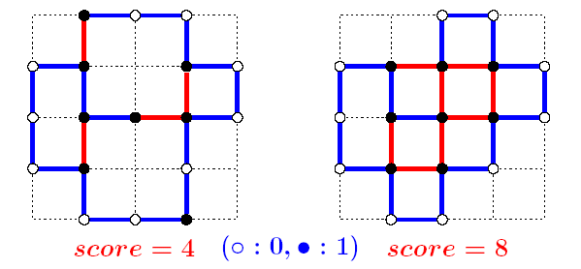
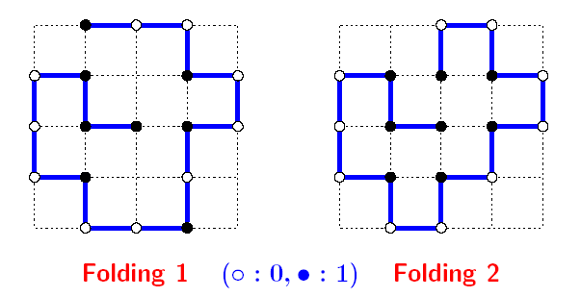
Folding Problem(Cont.)

Slide 16
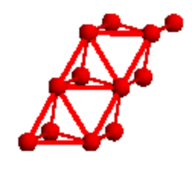
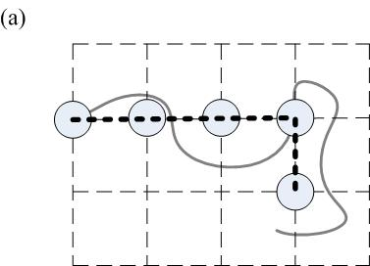
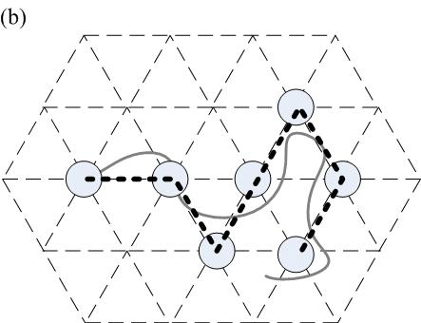
Lattice Model
Cubic Lattice Model
Face Center Cubic Model (Triangular)

Slide 17
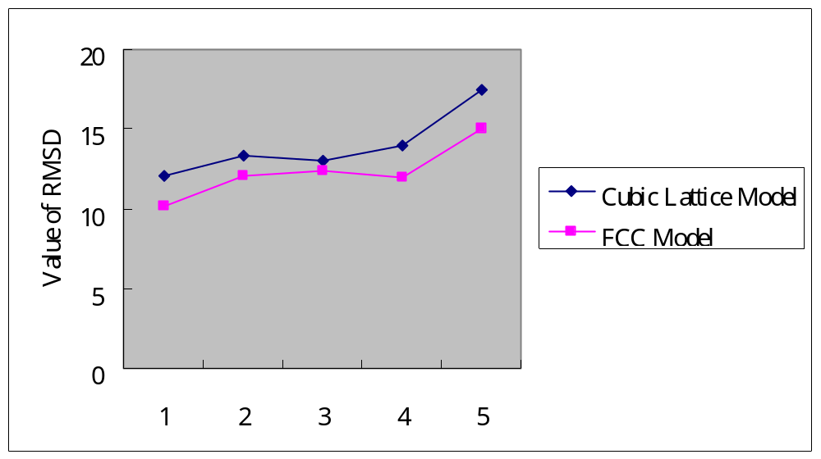
Cubic Model v.s. FCC Model
 | 1b1u | 1a6n | 118l | 102l | 1b8k
Cubic | 12.08891 | 13.35721 | 13.01421 | 13.98656 | 17.50644
FCC | 10.18907 | 12.09836 | 12.39913 | 11.93452 | 15.06346
Measured by RMSD(Å)
Data Source: PDB

Slide 18
Conclusion
The homology is based on those Presuppoitions.
The ab initio methods is limited by their score functions and searching methods.
No current ab initio protein folding algorithm is able to obtain very high accuracy (<3.0Å) for large protein structures

